Slide 1
WarmUp: Speed vs. Velocity
Can you give an example in which your speed is staying constant, but your velocity is changing?
~67% → Something (person, car, train, etc.) turning without changing speed
~33% → Had conceptual problems
~8% → Reversing direction on a road

Slide 2
WarmUp: Speed vs. Velocity
“as a rock is falling from a height its acceleration or speed stays the same nether decreasing or increasing but the velocity increases as it plummets downward.”
“While going in a circle, one's speed can be constant but the Velocity is changing because velocity accounts for direction.”

Slide 3
WarmUp: Speed vs. Velocity
How about an example in which your velocity is constant but your speed is changing?
~50% → Gave an example… Which means a big misconception!
~42% → Said it cannot be done!
~8% → Ignored the second part (lost a point)

Slide 4
WarmUp: Speed vs. Velocity
“b) stepping forward, then stepping back”
“An example of something with constant velocity but a changing speed is a car that varies in speed between 50 and 70 MPH, but stays in the same direction during the course of its travel.”
“There is no situation where velocity can remain constant with a changing speed, since speed is a part of velocity.”

Slide 5
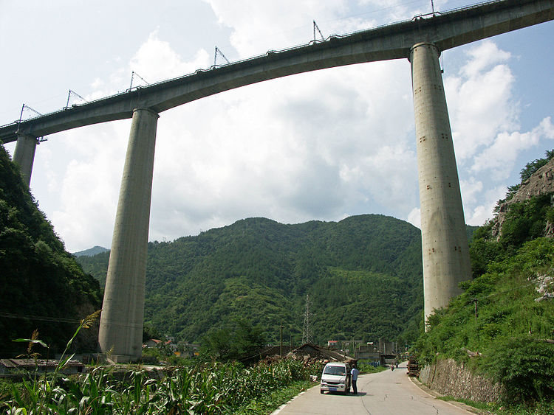
WarmUp: Falling Acceleration
If you drop a rock from a bridge, what happens to its acceleration while it is falling toward the water below?
~31% → It increases the whole way
~7% → It decreases the whole way
~7% → It increases at first, and then decreases
~4% → It decreases at first, and then increases
~52% → It stays the same the whole way

